Slide 1
Meeting Week 9
Last week summary
FP-LPV baseline in LFR format
  M(Y) invertibility
  LFR format
  Well-Posedness
  Algebraic loop
    Problem with Jan’s code and possible workaround
Outline ToDo next week

Slide 2
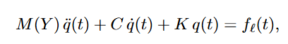
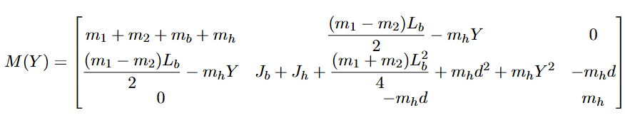
Last week summary
Currently working on converting the FP-LPV baseline into LFR format
Last week discussed:
  Frozen LTI baseline verification in python
  Need to check M(Y) is invertible
  Need to convert to LFR format
  Proposed feedforward in simulation

Slide 3
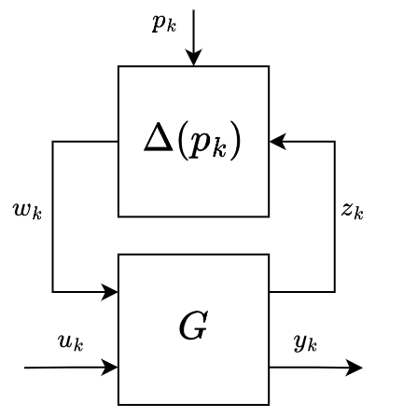
LPV-LFR structure

Slide 4
LPV-LFR structure
Symbol | Meaning
p_k | Scheduling variable
u_k | External input
y_k | System output
z_k | Internal output (G → Δ)
w_k | Internal input (Δ → G)
Block | What it is
G | Constant interconnection matrix: all dynamics, no P-dependence
Δ(p_k) | Scheduling block: all P-dependence isolated here

Slide 5
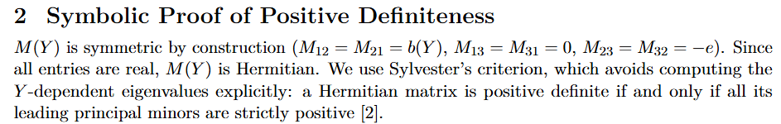
M(Y) invertibility
Holds for all Minor 1, 2 and 3 for the 3x3 symmetric matrix
→ Invertible

Slide 6
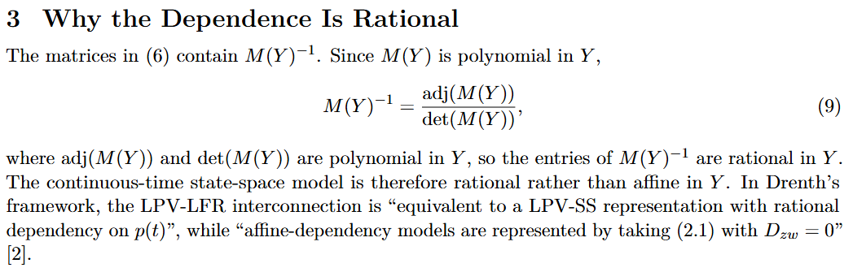
LPV-LFR derivation

Slide 7
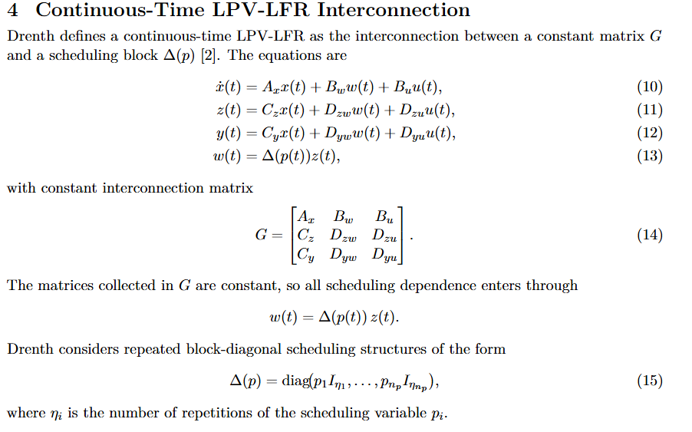
LPV-LFR derivation

Slide 8
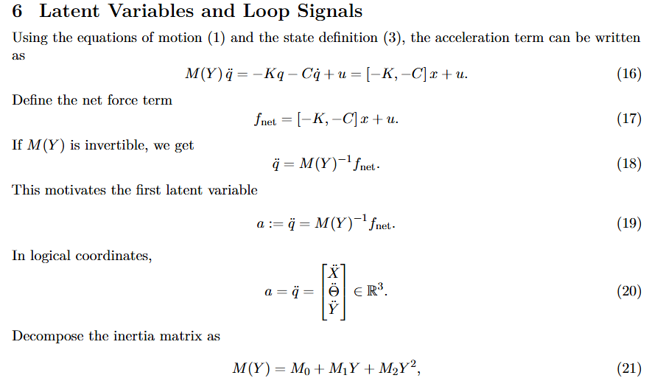
LPV-LFR derivation

Slide 9
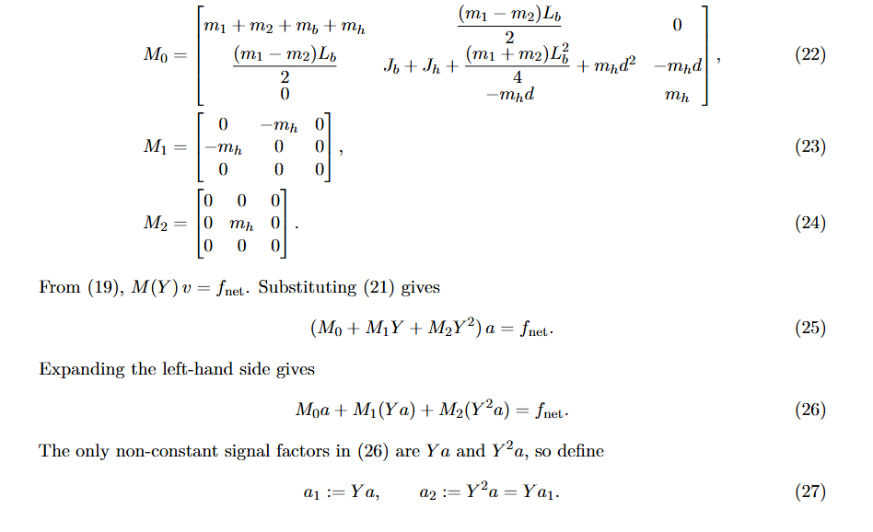
LPV-LFR derivation

Slide 10
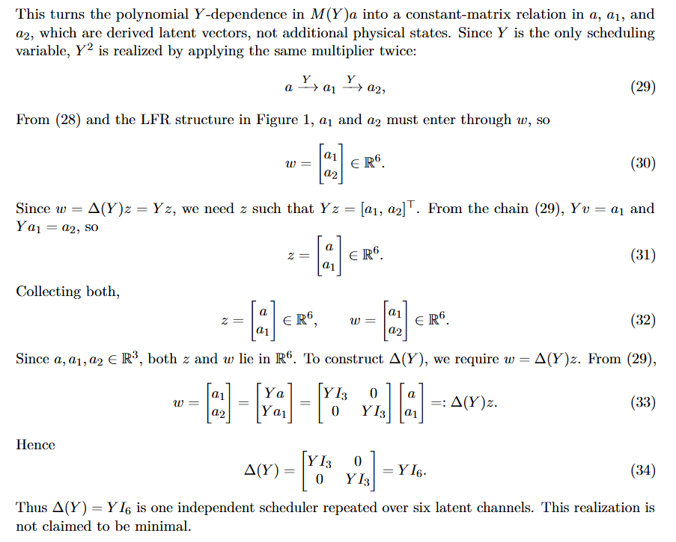
LPV-LFR derivation

Slide 11
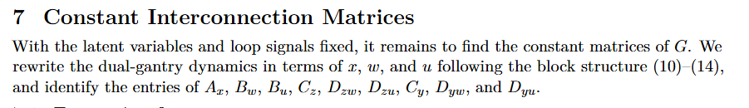
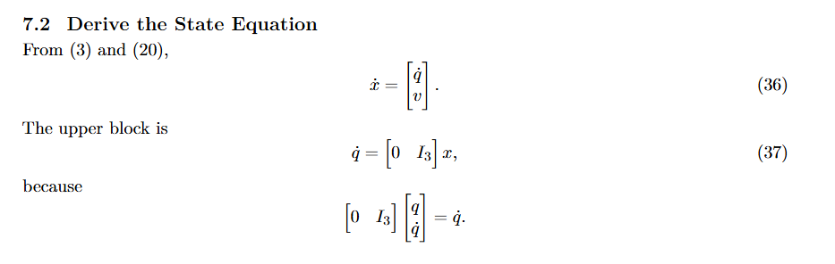
LPV-LFR derivation

Slide 12
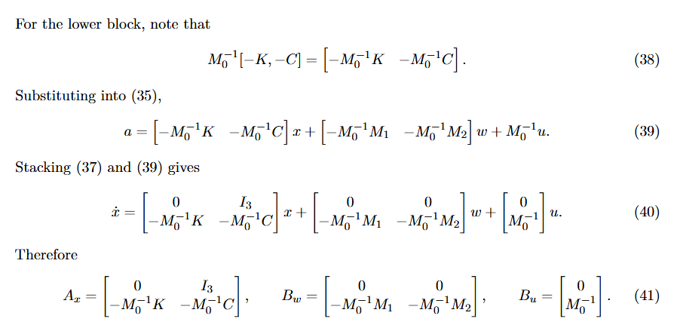
LPV-LFR derivation

Slide 13
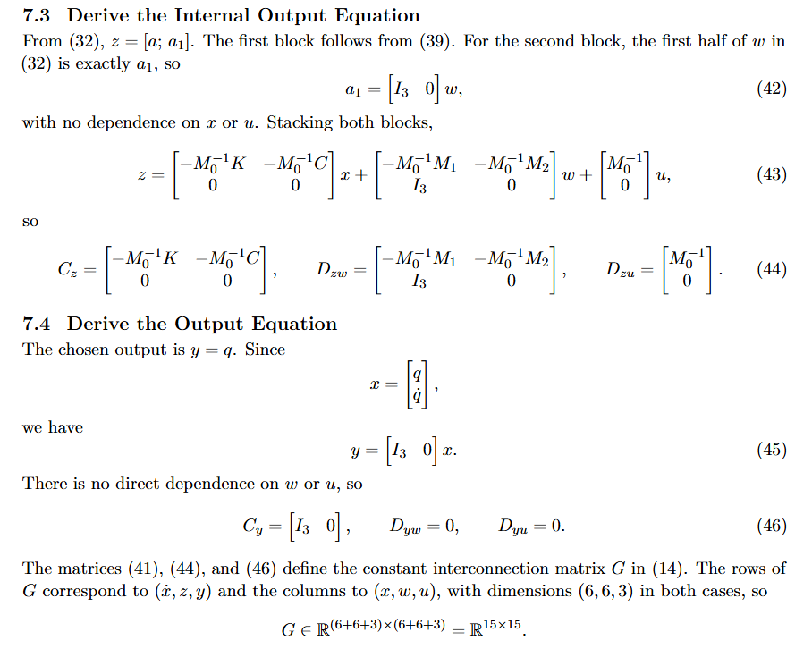
LPV-LFR derivation

Slide 14
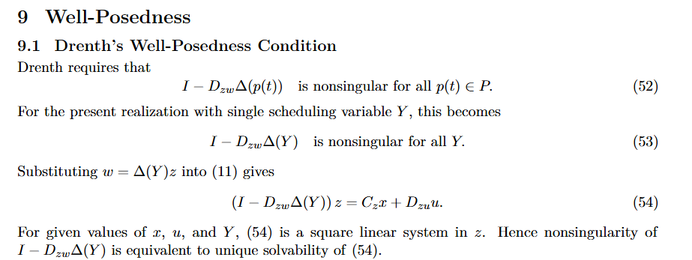
LPV-LFR derivation

Slide 15
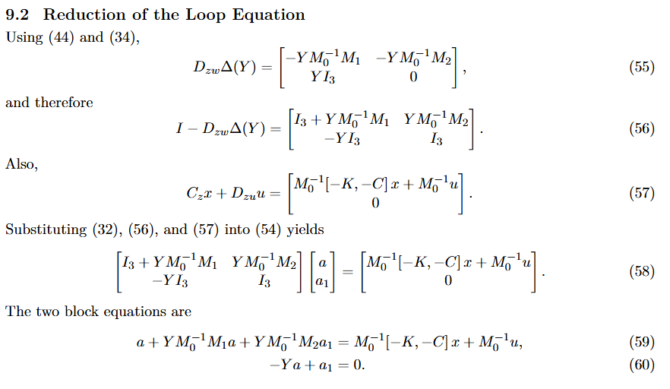
LPV-LFR derivation

Slide 16
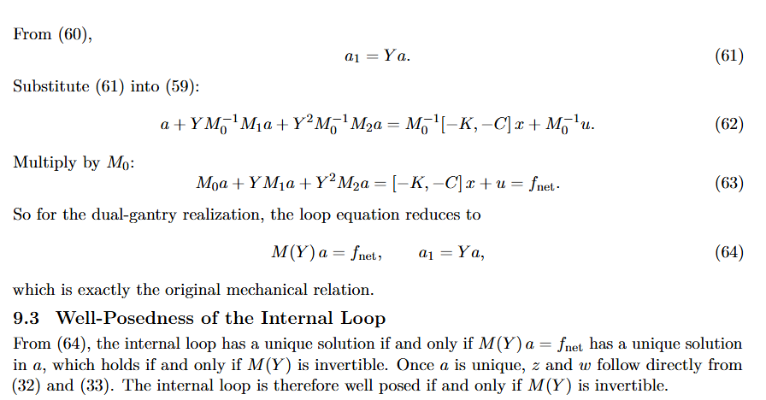
LPV-LFR derivation

Slide 17
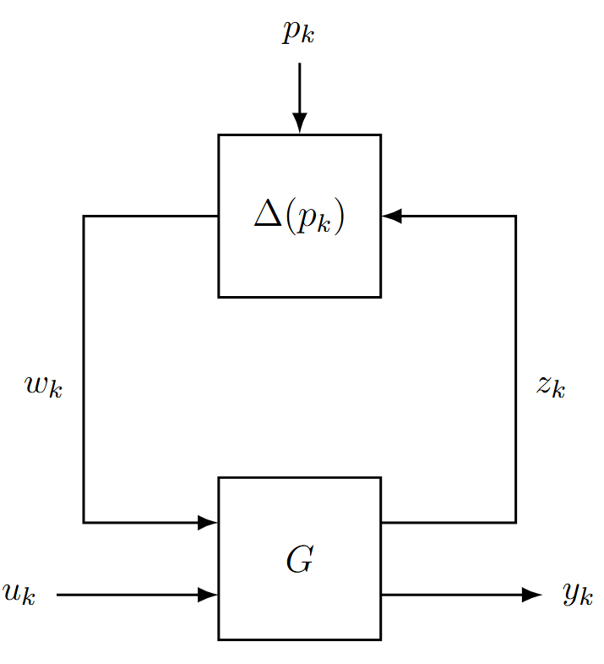
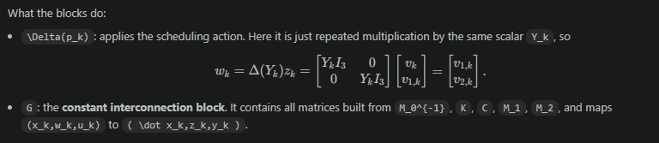
Y is the payload’s single-axis position
Y does not include x,y,z; it is only the coordinate along the Y-axis

Slide 18
LPV-LFR structure
Symbol | Meaning | Gantry
p_k | Scheduling variable | Current payload position along the Y-axis
u_k | External input | Generalized logical force input u_k
y_k | System output | Yk = qk qk = [Xk, thetak, Yk]^T
z_k | Internal output (G → Δ) | Internal signal sent to the scheduling block
w_k | Internal input (Δ → G) | Scheduled image of z_k fed back into G
Block | What it is | Gantry
G | Constant interconnection matrix: all dynamics, no P-dependence | Constant matrices built from M_0^{-1}, M_1, M_2, C, K
Δ(p_k) | Scheduling block: all P-dependence isolated here | Applies the current scheduler Y_k to the latent signals: Δ(Y_k) = Y_k I_6

Slide 19
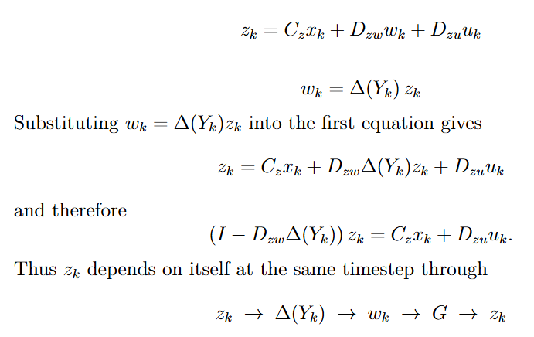
Algebraic loop

Slide 20
Algebraic loop

Slide 21
Algebraic loop
Loop only disappears when Dzw = 0, this is only the for the affine case. Gantry is rational.

Slide 22
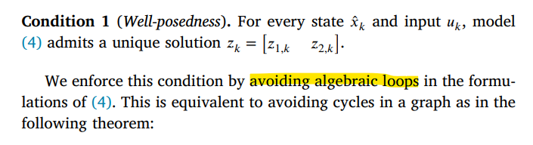
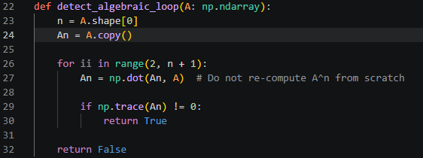
Conflict with Jan’s code
Derivation does have a unique solution, but Jan’s code does not work with algebraic loops.
Jan’s Interconnect requires acyclic signal graphs
Graph cycle detection via matrix powers: compute powers of the signal adjacency matrix A² through Aⁿ.
If any diagonal entry becomes nonzero, a
cycle exists (a node can reach itself).

Slide 23
Found it. Line 135 in interconnect.py:
assert not detect_algebraic_loop(directional
_signal_connection_matrix)
This is in init_forward() — called once
before the first forward pass. Jan builds
the signal graph as a directed adjacency
matrix, then calls detect_algebraic_loop()
on it. If a loop exists, the assert fails
hard. Let me find what that function does
The detection method is: compute powers of
the signal adjacency matrix A² through Aⁿ.
If any diagonal entry becomes nonzero, a
cycle exists (a node can reach itself). This
is the standard graph-theoretic cycle
detection via matrix powers.
The assert in init_forward() means: if a
loop is detected, the framework raises
AssertionError and refuses to initialize.
There is no fallback, no resolution — it
simply does not run.
This is not stated in the paper — it is a
hard constraint enforced in the code.

Slide 24
Possible Solutions
Collapse
  Not true LFR structure → Is this problematic…
DAE
Rewrite rational to affine

Slide 25
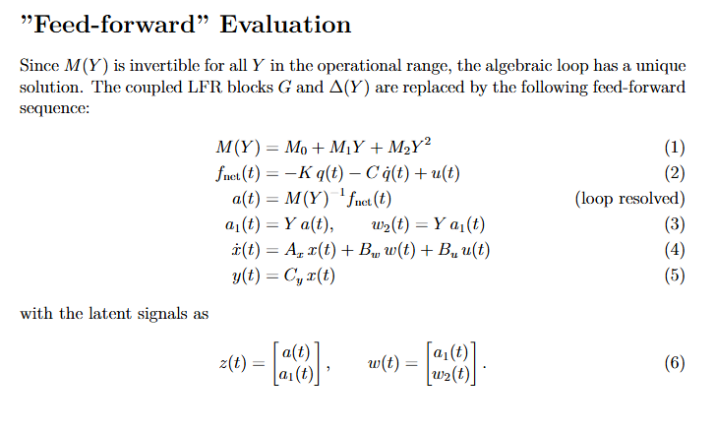
Possible Solutions

Slide 26
The resolve-and-retain approach is the bridge: solve the
algebraic loop analytically once (producing z₁ =
M₀⁻¹(fnet − M₁w₁ − M₂w₂), which collapses to M(Y)⁻¹
fnet), substitute back, and hand Jan's framework a signal
graph with no loop. The unique solution that the LFR
guarantees is computed explicitly, and from that point
forward the framework sees only feed-forward signals.

Slide 27
Outline next week
Workaround for algebraic loop
Implement in simulation
  Adjust for Jan’s augmentation code

